Slide 1


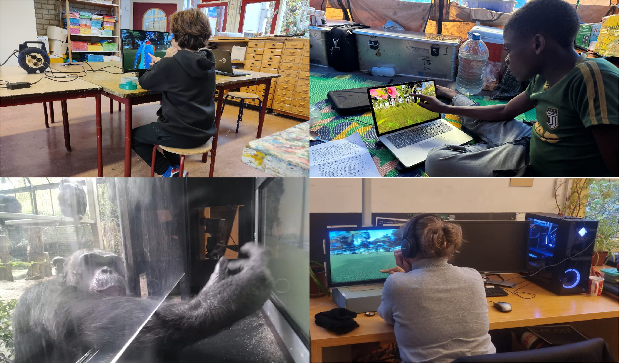
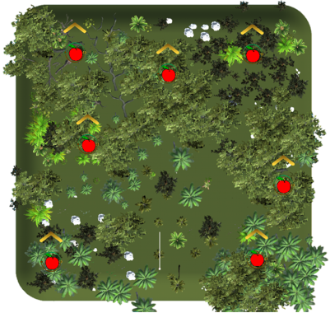
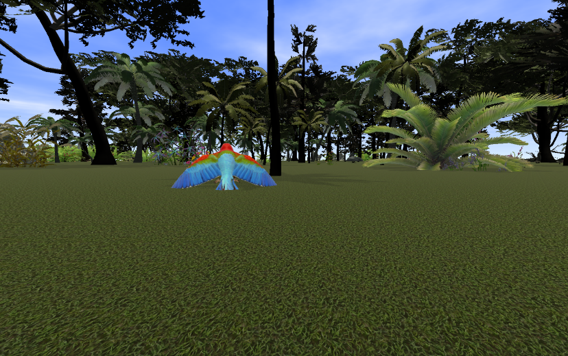
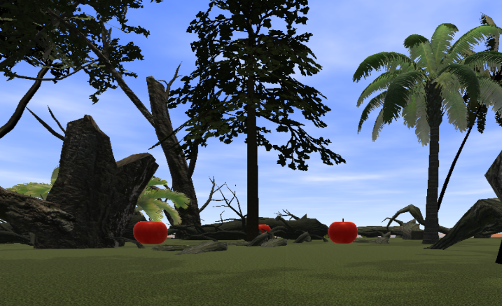
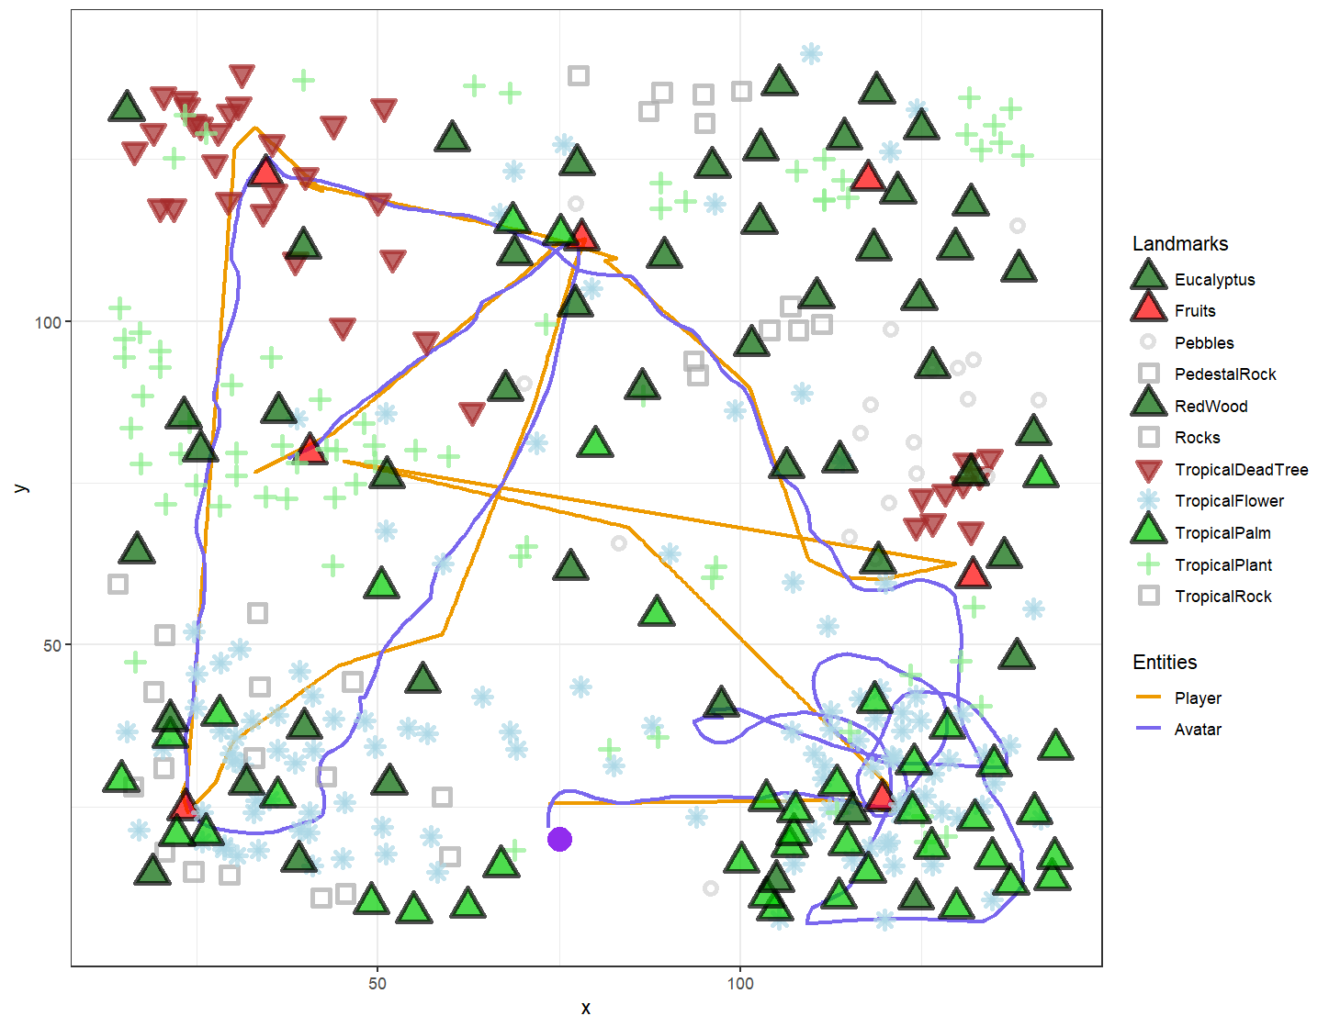
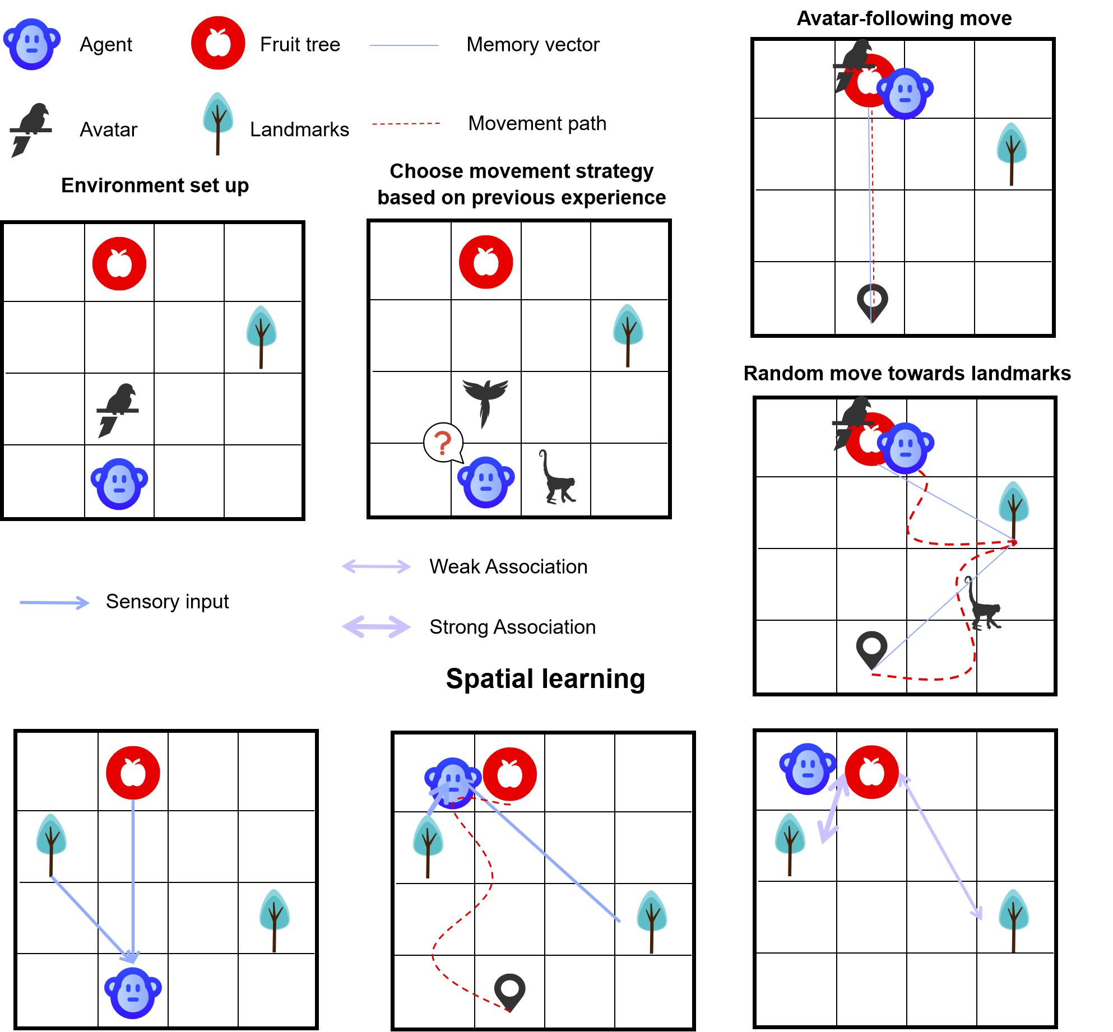
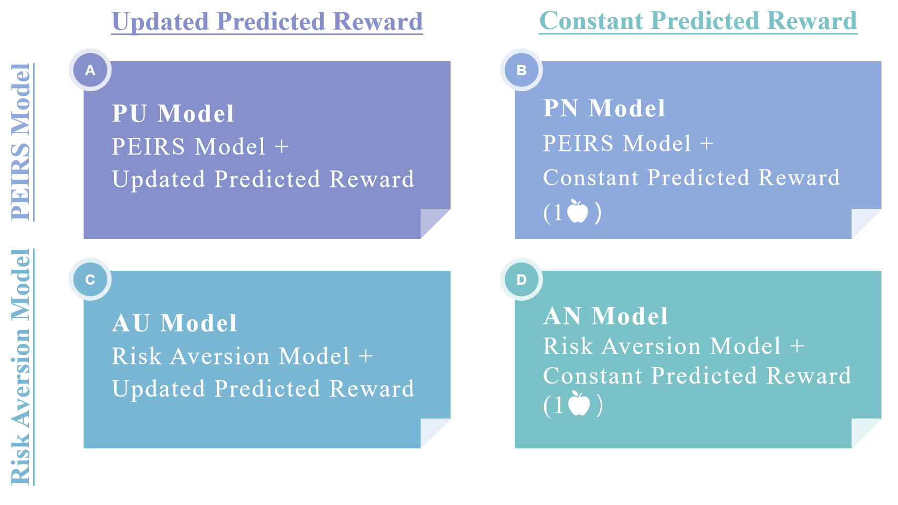
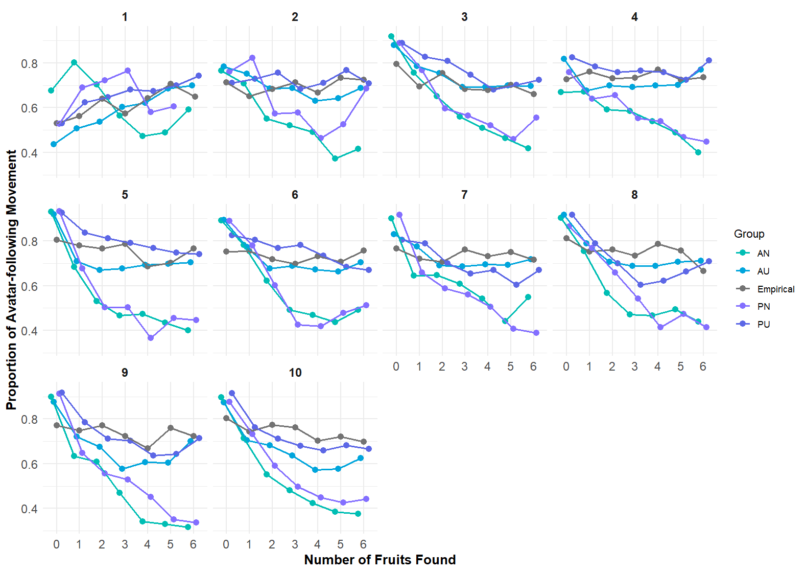
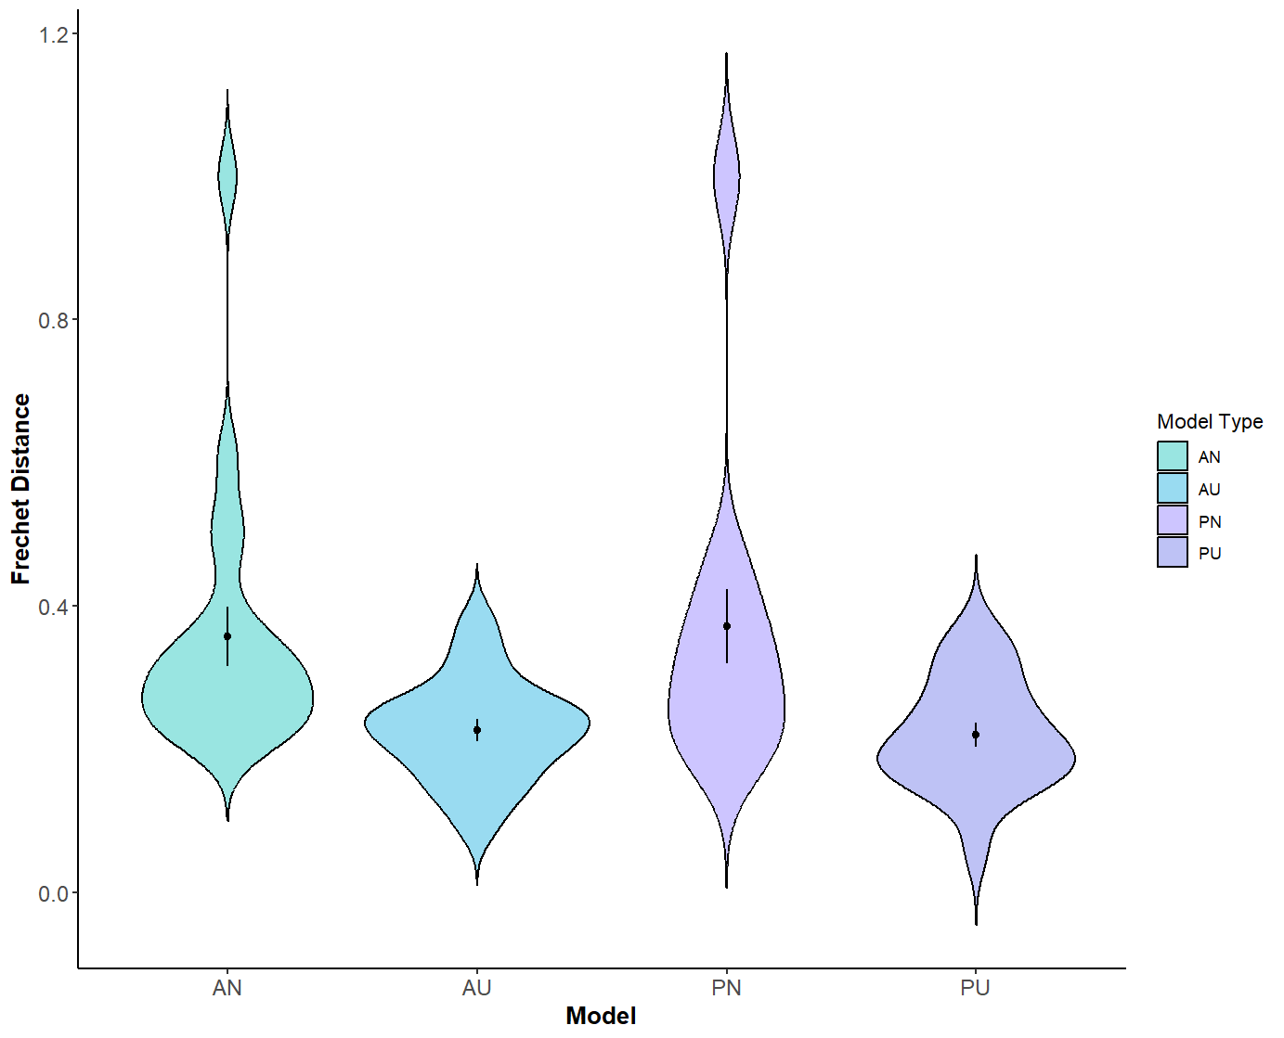
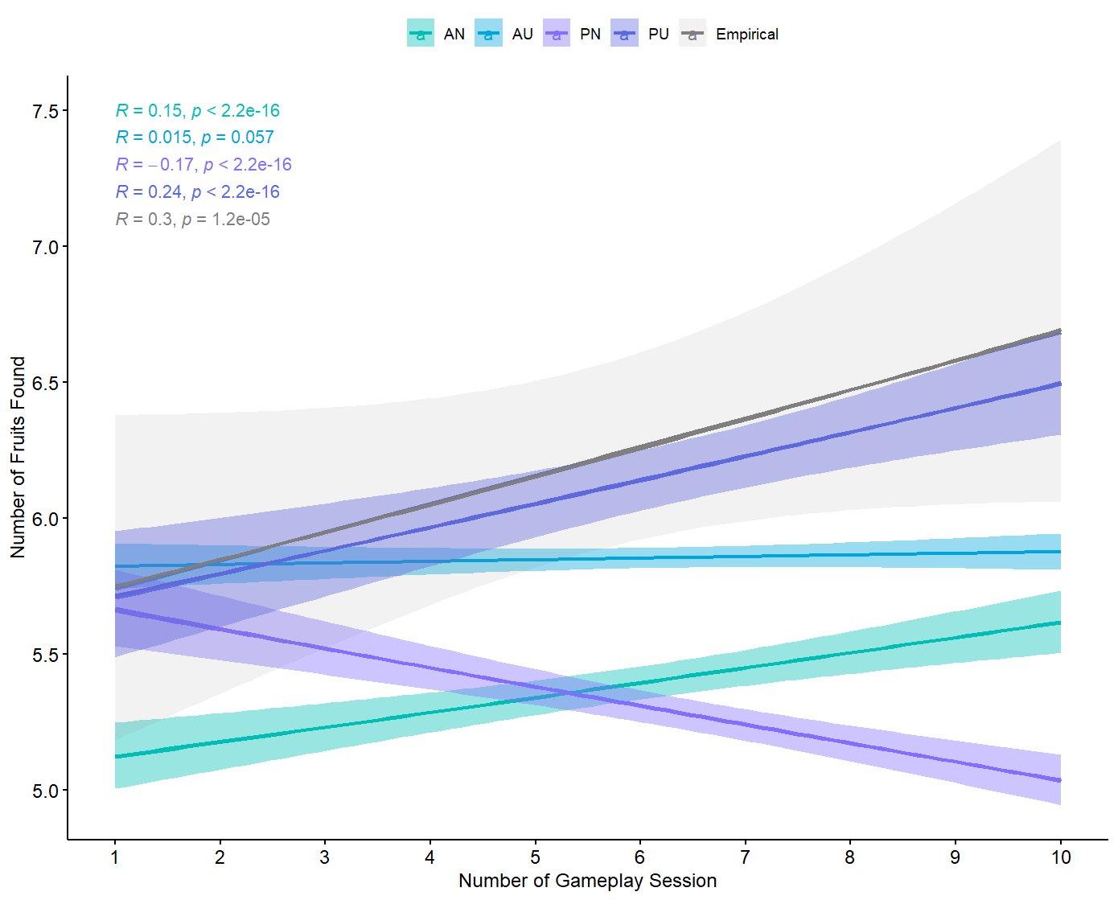


Revealing cognitive mechanisms in primate movement by twinning experiments with an agent-based model
Muhan Li, Evy van Berlo, Pia den Braver, Bram van der Perk, Vonne Smit, Bryndan van Pinxteren, Eva Leferink, Karline Janmaat, Emiel van Loon
Institute for Biodiversity and Ecosystem Dynamics - University of Amsterdam
Introduction
Animals optimize foraging decisions under uncertainty. Especially in fission-fusion societies foraging decisions are complex because the uncertainty in both public and private information about food location and availability can be large.
The cognitive mechanisms by which uncertainty in foraging is perceived, learned and evaluated remains poorly understood.
We developed a computer game and an agent-based model (ABM) as a 'digital twin' to gain more insight into these cognitive mechanisms in primates. The computer game is used to record participants behaviour systematically while the ABM is used to interpret the results.
The game has been played successfully by human children and adults with different cultural backgrounds as well as chimpanzees.
Computer game
Pictures of children used with their & their caretaker’s permission
Participants navigated a virtual forest containing 7 fruit-bearing trees over 10 repeated game sessions. Each session started at the same location where an avatar appeared. The avatar moved towards a random fruit tree, hence acting as a public cue. When the participant reached a fruit tree it was depleted. Hence, the avatar’s reliability declined within a game session as the probability of leading to depleted fruit trees increased. The game ended when all 7 fruit tees were depleted or after 600 seconds. To support spatial learning, each fruit tree was surrounded by a unique landmark configuration. The fixed spatial layout across sessions allowed participants to combine public information from the avatar with private memory of past encounters.
From left to right: game map, still of screen while following avatar, screen while fruit tree is reached & map of movement paths based on logged results.
Agent-based model
Tested mechanisms
Fixed mechanisms
The agent moves straight towards the avatar during following movement.
1. ABM replicates the follow/explore dynamics of participants when agents are tuned to the initial following proportion observed in the gameplay session.
2. Prediction Errors Induce Risk Seeking (PEIRS) model more accurately captures the follow dynamics of participants according to novel neurobiological findings (Moeller et al., 2021).
3. Models which better capture follow/explore behaviour also more closely reproduce empirical foraging patterns.
1 Detection range: The agent can see objects within a 120-degree field of view in front of it and within 40 meters.
2. Strategy updating: The probability of the agent to follow the avatar or search independently is calculated using the SoftMax algorithm based on the previous success and the learned risk of following avatar versus uncertainty of personal knowledge.
3. Risk learning: Learned risk of following the avatar is updated based on the reward prediction error (outcome - predicted reward).
Follow
Explore
Random exploration is directed by a combination of visual stimulus vectors and memory vectors.
Associative reward is used for weighting the movement vectors and assess the uncertainty of personal knowledge.
Results for humans
A smaller Frechet distance implies a smaller difference between a model
and an empirical trajectory
Agents and human primates initially follow avatars to optimize foraging, then reduce following based on learned risk
Models incorporating updating of the predicted reward (PU and AU) approximate the empirical following behaviour better.
Overall, PU and AU models more accurately reproduce patterns of avatar following behaviour.
The PU model reproduces empirically observed rates of fruit acquisition and learning dynamics best. The AU model still gets the amount of acquired fruit approximately right.
Conclusions
The combination of ABM and computer game validates the use of both as a powerful tool for generating and pre-testing hypotheses, particularly valuable in cognitive research where fieldwork remains challenging and resource-intensive.
Risk perception is a dynamic process rather than a fixed defense mechanism, enabling primates to optimise both learning and resource acquisition in unfamiliar habitats.
Risk-seeking information use facilitates the exploitation of public information, reducing reliance on costly individual exploration and enhancing foraging efficiency.
This study reveals foraging as a potential ecological origin for using risky public information, offering insights into the evolution of decision-making and its modern societal implications.
Acknowledgements: Thanks to Templeton World Charity Foundation for providing fundings to this research. Thanks to Matthias Allritz and Rafael Bidara for their contributions to the development of the VR foraging game, which was instrumental to the implementation of this research. Thanks to Anne van Dijk for coordinating the research at ARTIS Zoo, and to the zookeepers whose dedicated care of the chimpanzees made this study possible. Finally, we thank all human and chimpanzee participants whose voluntary involvement was fundamental to the success of this project.
Details about this study:
Reference: Moeller, M., Grohn, J., Manohar, S., Bogacz, R., 2021. An association between prediction errors and risk-seeking: Theory and behavioral evidence. PLoS Comput Biol 17, e1009213. https://doi.org/10.1371/journal.pcbi.1009213
Contact: Muhan Li muhan.li2@student.uva.nl

